Slide 1
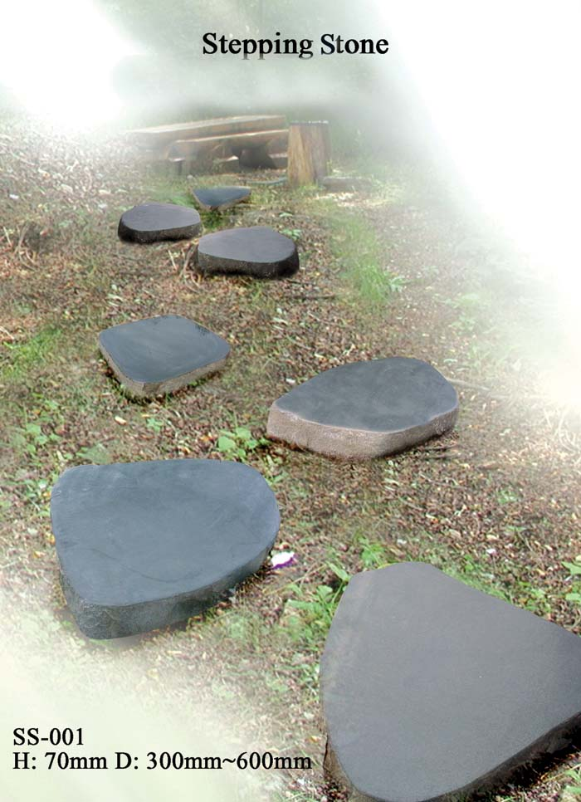

Presentation
Fiji Network for people living with HIV and/or AIDS (FJN+)

Slide 2
FJN+
Non Government Organization Registered under Charitable Trust Act of Fiji in 2004
Formed in 30thof June, 2003 – 8 PLHIV and Dr Jiko Luveni
47 members – HIV + with more that 100 active volunteers
4 Component
- Capacity Building
Care and Support
Advocacy
Income Generation

Slide 3
Vision
People living with HIV remain socially integrated and lead positive and productive lives.
Mission:
To improve the quality of lives of people living with HIV and their Families.
Objectives:
To promote the overall quality of people living with HIV in Fiji.

Slide 4
Location
Old Government Pharmacy
Rodwell Road
Suva
P: 00679 3310 958
F: 00679 3319 145

Slide 5
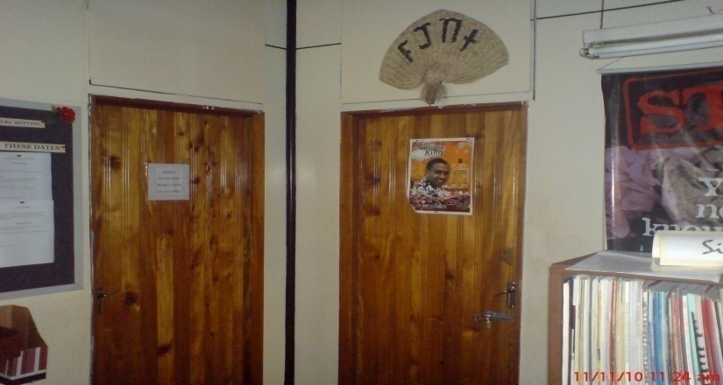
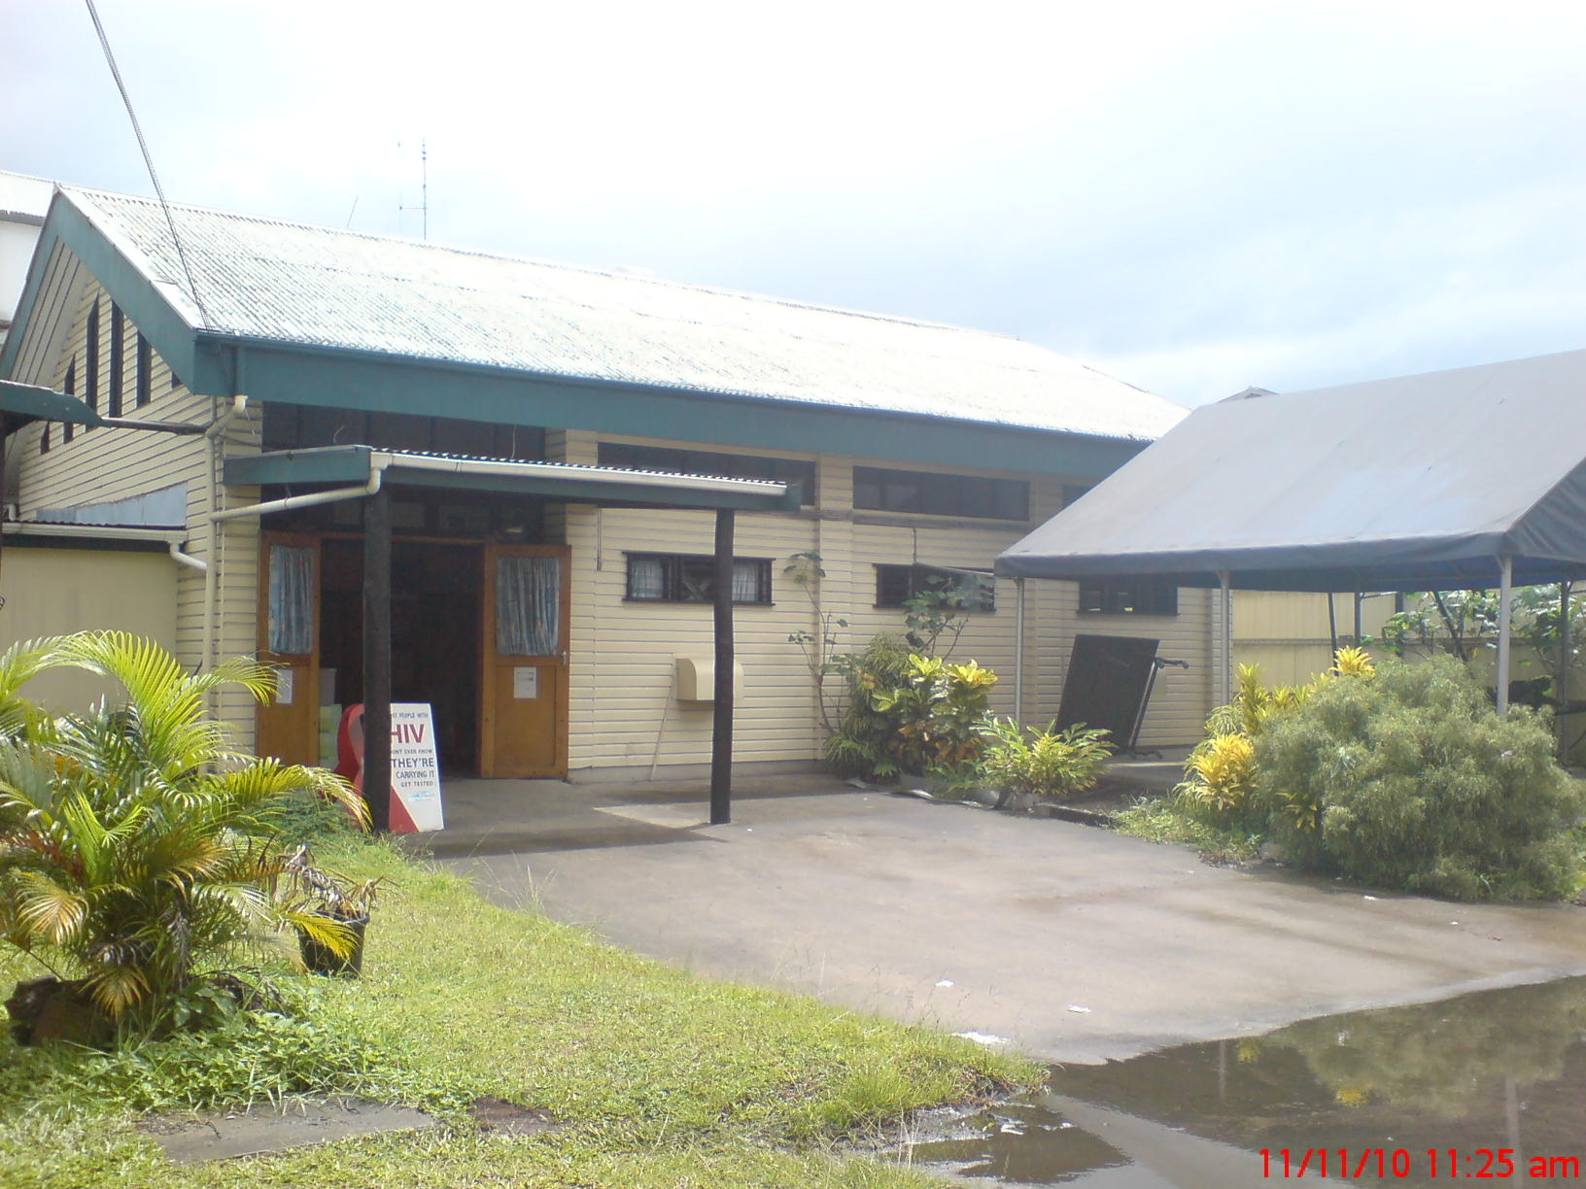
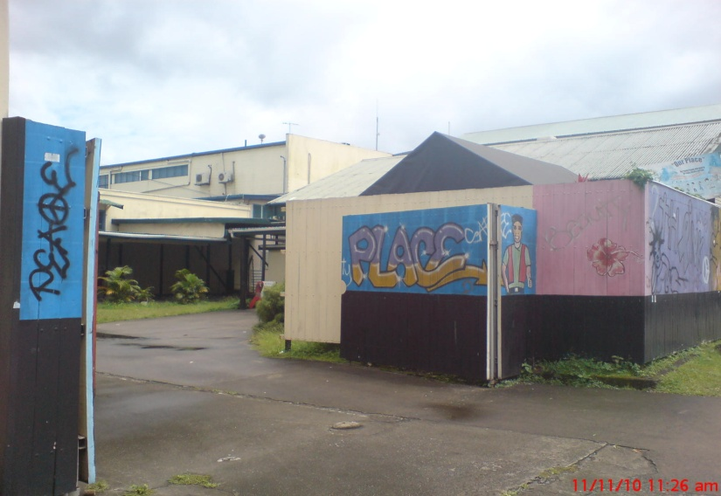
Office Galleries

Slide 6
SS Training
Matata Village, Lami

Slide 7
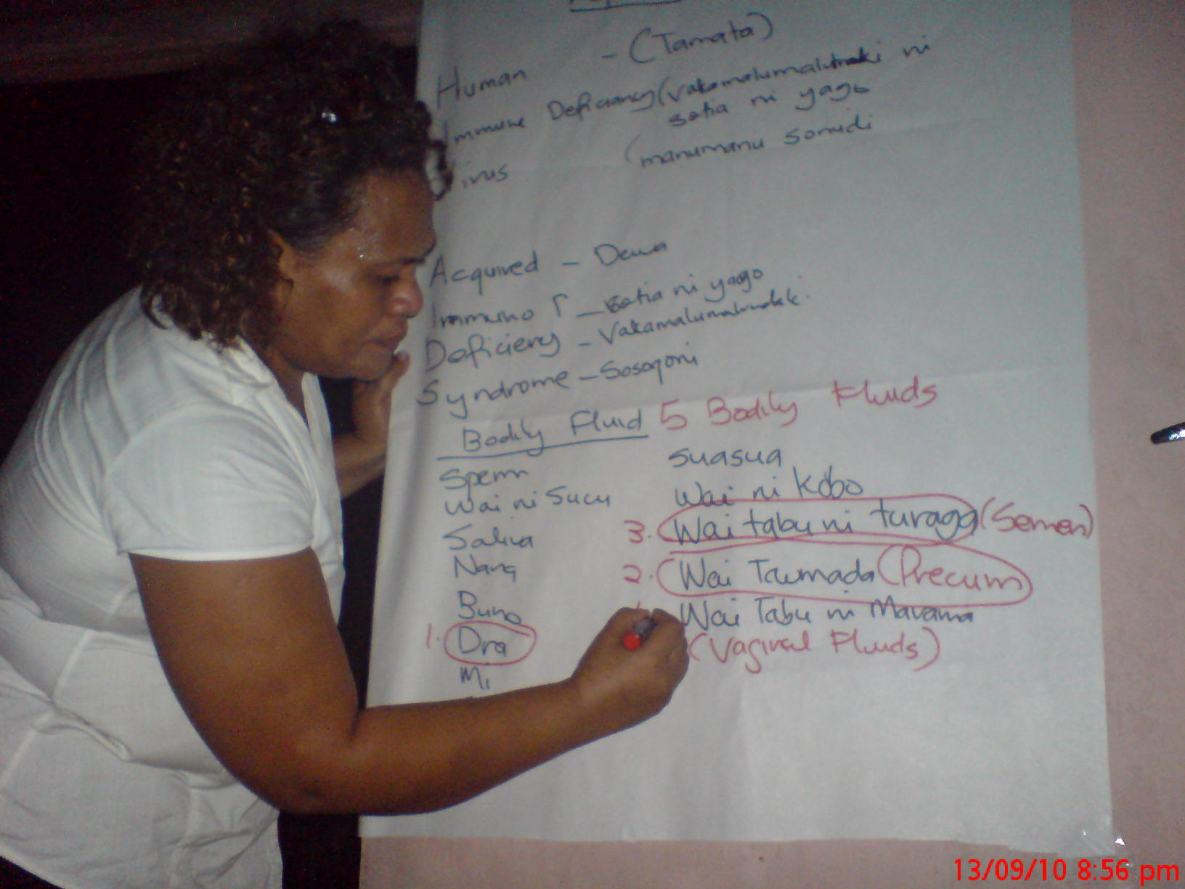
Facilitators
Mr Joeli Colati (Young Male)
Mr Loqi Cati (Older Male)
Ms Leba Kania (Young Female)
Ms Lili Gonerogo (Older Female
Resource Persons
Mr Tura Lewai (Gender Equality - FSPI)
Mr Mosese ( MSC – FJN+ Volunteer)
Mr Sitiveni Tuvou (STIs – Reproductive Clinic)
Mr Mitieli Delasau (Logistics)

Slide 8
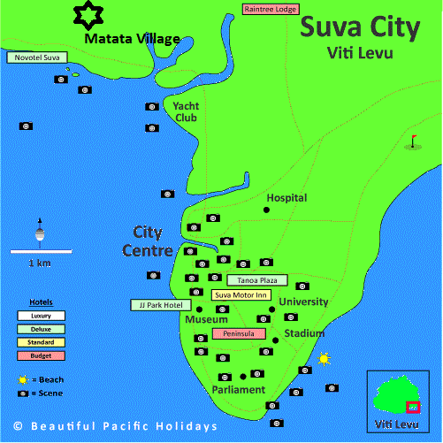

Map for the SS Training Venue

Slide 9
Why we chosen Matata to be our SS Implementation community
More vulnerable to HIV and other STIs due to the location of the Community
More Teenage Pregnancy
No Training ever been done on any Issues such as Gender Equality, Human Rights and especially on HIV and AIDS and other STI’s
More young couples settles in the community
Peer Pressure is very high among youths especially in Drug abuse, Alcohol and sexual activities.
More School drop out
Poverty rate is very high
No knowledge on Safer sex

Slide 10
Reports Finding

Slide 11
Participants Graph

Slide 12
Knowledge and Behavior Change
Data on the knowledge, attitudes and behavior of four group in Matata Settlement have been collected through Pre and post Test Questionnaires

Slide 13
% of Male and Female respondent that answered correct knowledge ‘questions correctly in Matata Settlement 2010 SS training

Slide 14
Proportion of Participants with correct knowledge of HIV prevention.
Question | YM | YF | OM | OF
Having sex with only one, faithful uninfected partner can reduce the change of getting HIV ? | 2 | 2 | 1 | 1
Using Condoms correctly can reduce the chance of getting HIV? | 3 | 1 | 2 | 1
A healthy looking person can be infected with HIV? | 1 | 1 | 1 | 1
A person can get HIV from Mosquito bites? | - | - | - | 1
A person can get HIV from sharing a meal with someone who is infected with HIV? | 5 | 4 | 2 | 1
All Answers correct: (none)

Slide 15
% of Male and Female respondent that answered correct knowledge ‘questions correctly in Matata Settlement 2010 SS training

Slide 16
IEC Material Distribution

Slide 17
Strength
Facilitators
Background knowledge – HIV 101 and Life skills
Team work spirit
Level of Flexibility
Full time Volunteer and Secretariat – FJN+
+ Network
PLHIV Facilitator
Adding reality stories to the presentation to evidences information
Target influential people like church leaders and community leaders
MSC Collection – To back the evidence of the training
Participant
Flexibility
Team work spirit
Not sensitive toward Issues
Open Minded
Committed to the program

Slide 18
Con’t
Energetic
Creativity
Participants coming from same denomination
Person sharing and testimony

Slide 19
Weakness
Facilitators :
Work commitment at FJN+ (Especially in Filling up the Jornals)
Lack of communication – Communication breakdown
Using of Acronyms especially in the area of STIs topic
Context (STIs Presentation) – (Recon - contextualize terms to suit the participant.
Speed of conduct the training (Facilitator speed to be the same as Writer)

Slide 20
Con’t
Participants
Open discussion (young women very hard to open up)
More participant are uneducated – (Really need the explanation to be clearly and slowly due to Illiteracy
More Participant involves in sports

Slide 21
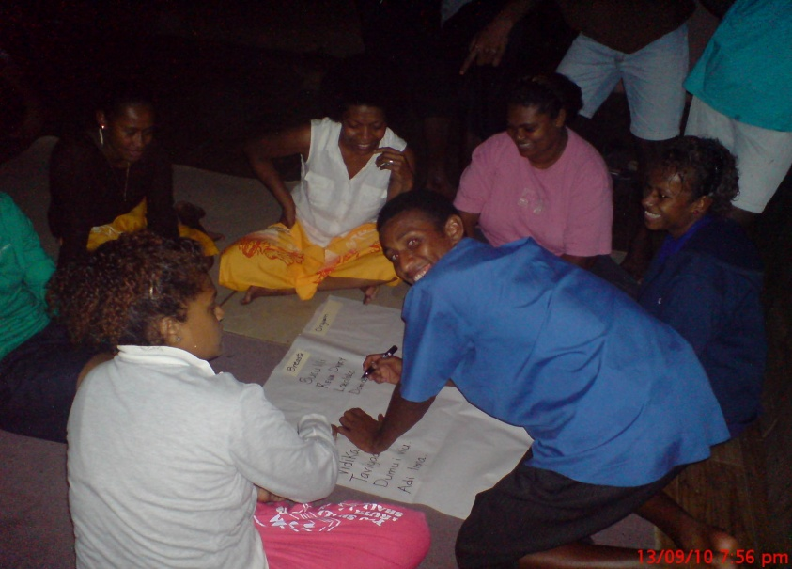
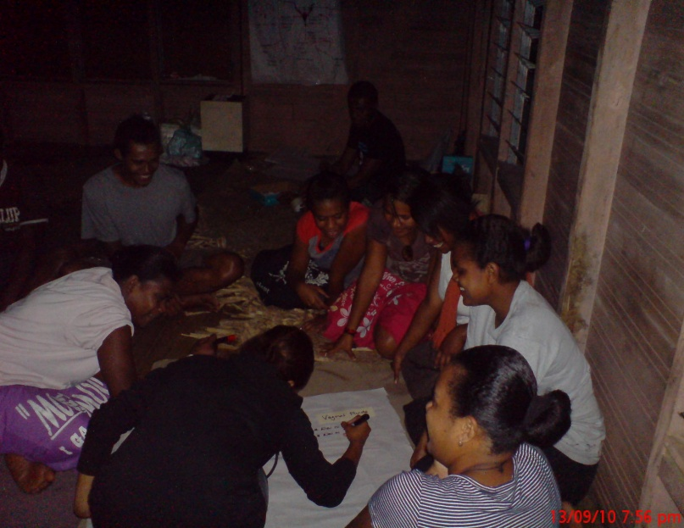
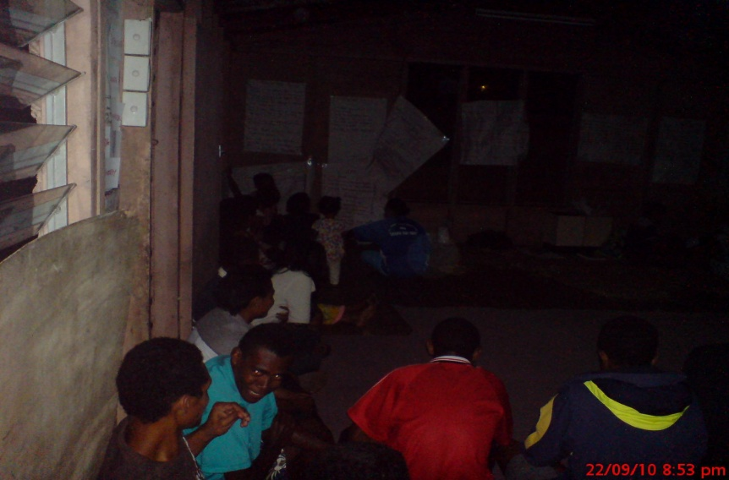
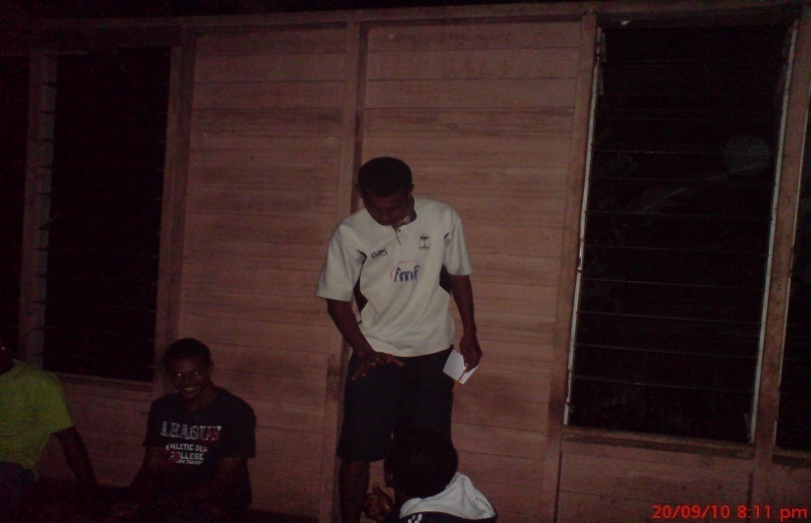
Group work Galleries

Slide 22
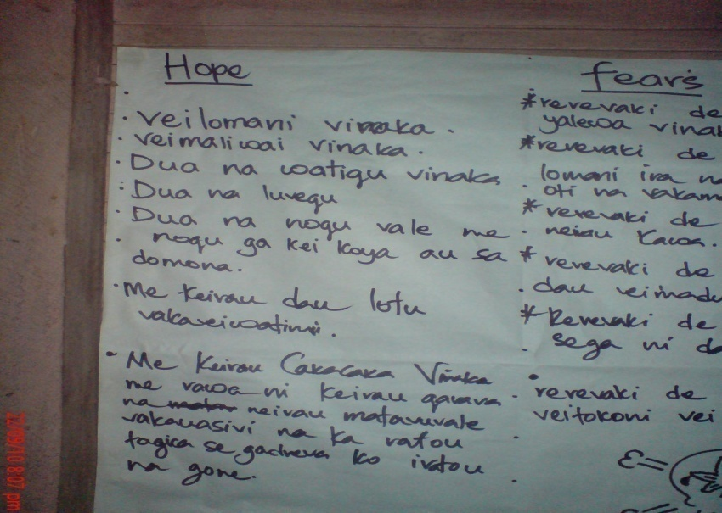
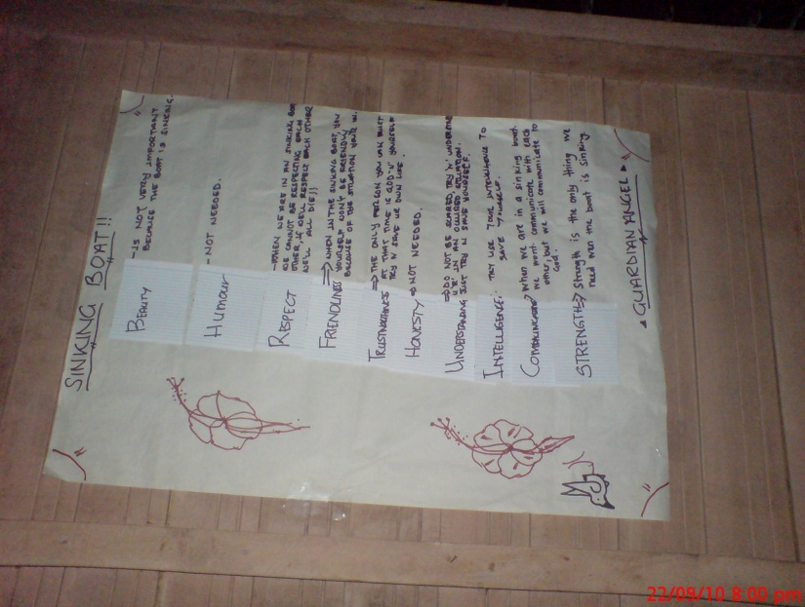
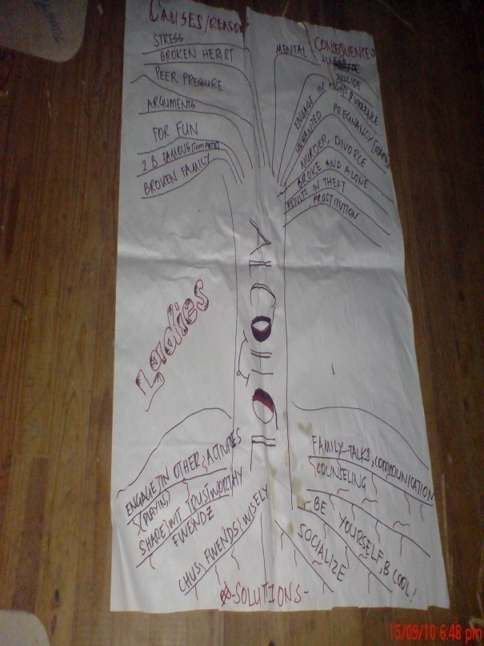

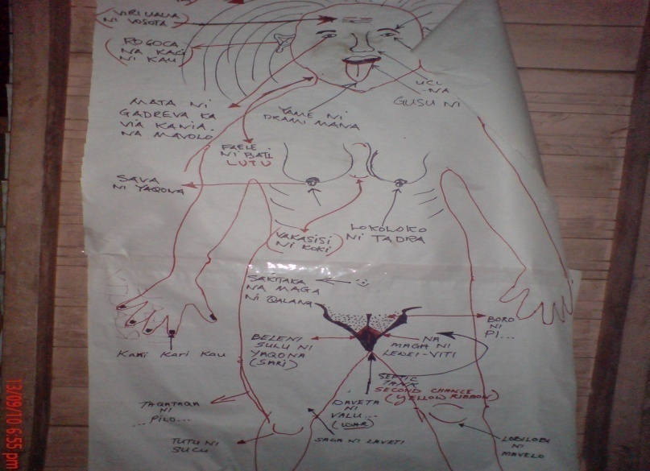
Idea and contribution during training Image

Slide 23
Concerned from Facilitators
Why many women cannot present well?
The crowd which are not part of the training, how to cater for them?
According to some women participant they like to have joined session with Boys because its fun.
More Participants – Less food

Slide 24
Recommendation
More time needed for the SS Training (more time for discussion)
Consider the SS venue due to some communities they don’t have proper lights, Carpet (due to cold floor) and etc (this could affect the Training)
If the training could happen 3 times in a year (Due to our timeline – 1 Month)
To have separate venue for each group (4 groups sharing the same roof) – Participant complained about other group due to noisy level.
Incentives
Transport Allowances due to Geographical location
DSA and meal allowances – Because its out of work station (More session in the Night)

Slide 25
Con’t
National Retreat – To learn from other facilitators
Fijian Questionnaire to be pretest again with contribution from all Facilitators

Slide 26
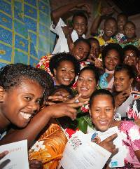
Media Coverage
RESIDENTS of a settlement in Lami are expected to be well versed with issues that make the community vulnerable to HIV.
This has been possible after a four-week training called Stepping Stones which is a training package in gender, HIV, communication and relationship skills.
The workshop was held at the Matata settlement in Lami and organised by the FJN+.
FJN+ representative Leba Kania (pictured) said Stepping Stones training was initiated by Foundation of the South Pacific International (FSPI), funded by Ministry of Health (MOH) and implemented by FJN+.
Ms Kania said the workshop had been effective in generating sustainable behaviour change in many communities.
"Using a facilitation approach, stepping stones helps community members to develop a greater social capital in relation to the issues that make the community vulnerable to HIV," she said.
Ms Kania said the training was designed to allow women, men and young people to address their relationships in a constructive, fair and equitable way.
She said people who went through the training would be able to explore their social, sexual and psychological needs, to analyse the communication blocks they faced, and to practise different ways of addressing their relationships.
"We are getting prepared for a Lakeba Roadshow in December, and we will be implementing, Life Skills, Stepping Stones, HIV 101, Transformational Leadership, Action Reflection Learning and HIV Specific Human Rights," she said.
The workshop had 50 participants who received their completion certificates from the Ministry of Health on Wednesday.
Meanwhile, World AIDS Day will be celebrated around the world on December 1.

Slide 27
Outcomes
Formed a new Community partner
Participants signed up to be FJN+ Volunteer
4 participant will be part of the WAD Road in Lakeba Island from the 14th – 29th December
Participant are been the gate Keepers in Matata Community

Slide 28
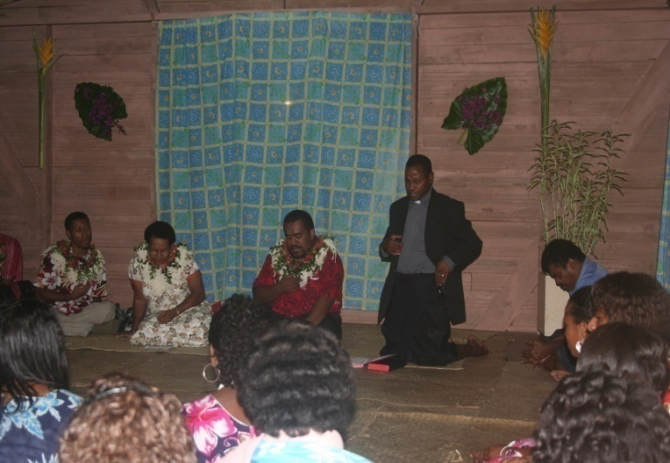
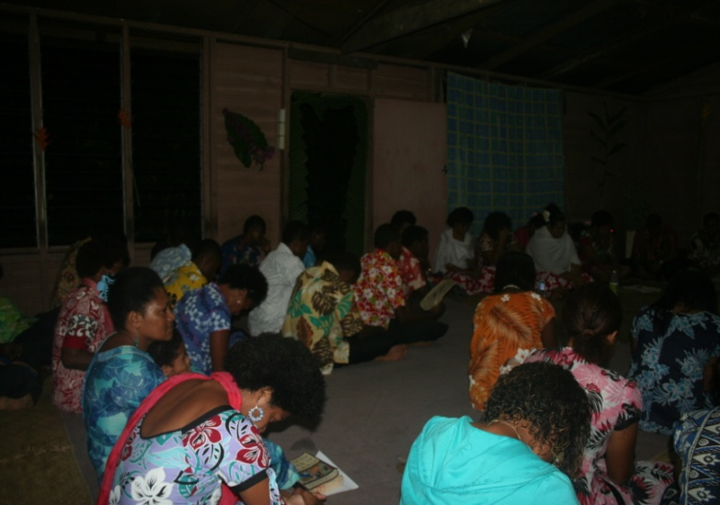
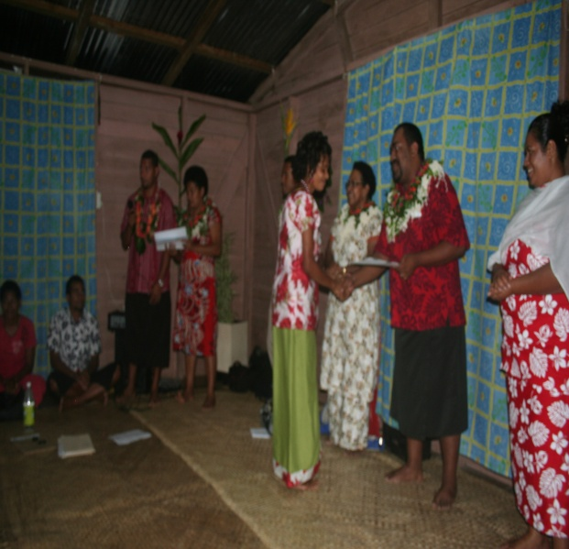
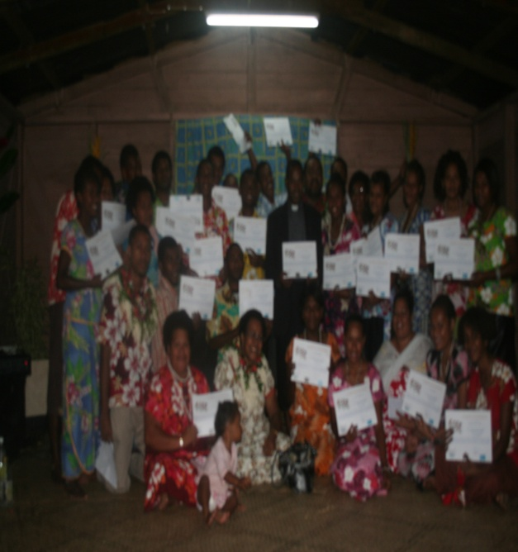
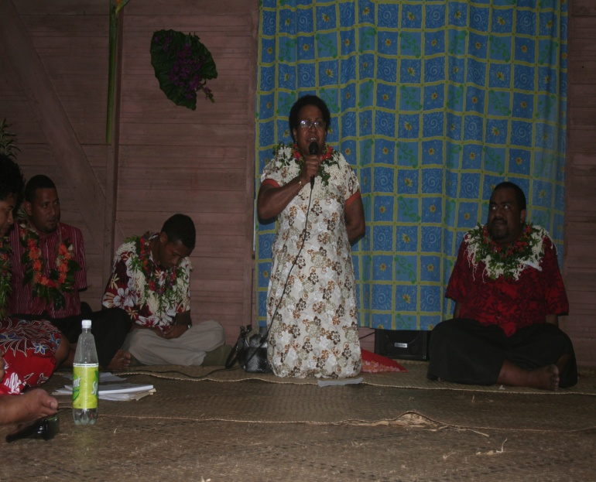
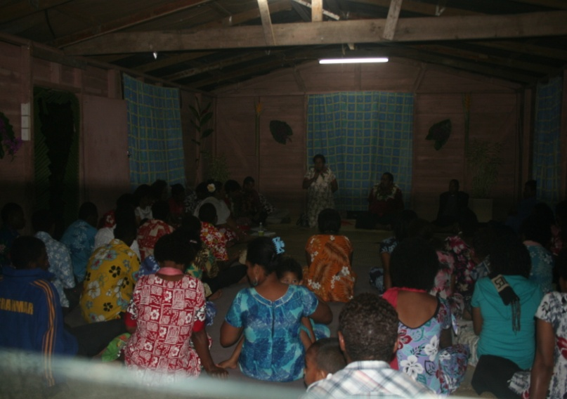
Certificate Galleries

Slide 29
To conclude!!!!!!!
The Illiterate of the Future are not those who cannot read and write, But those that cannot learn, unlearn and relearn………
People living with HIV are part of the solution and not the problem…….. We are just like you and me.

Slide 30
Vinaka Vakalevu for your Listening

Slide 31
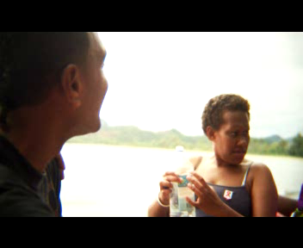
Reminder;
Be a Visible champion, encourage and support people living with HIV in the Pacific………

