Slide 1
Stepping Stone ….
Fiji
2010

Slide 2
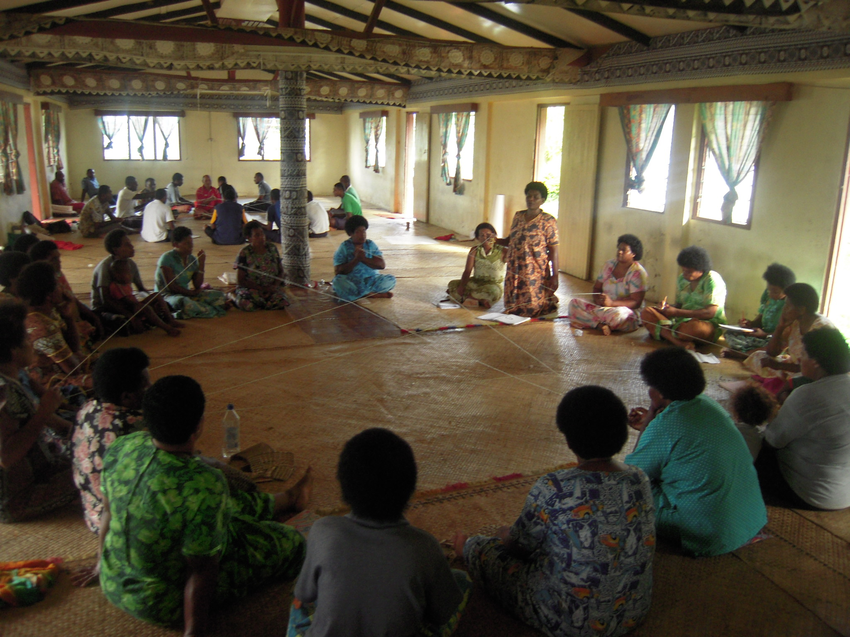
Community participation
8 communities were selected
Naitutu
Waikete
Kalabu MoH Co-Facilitators
Nacula
Namoli

Slide 3
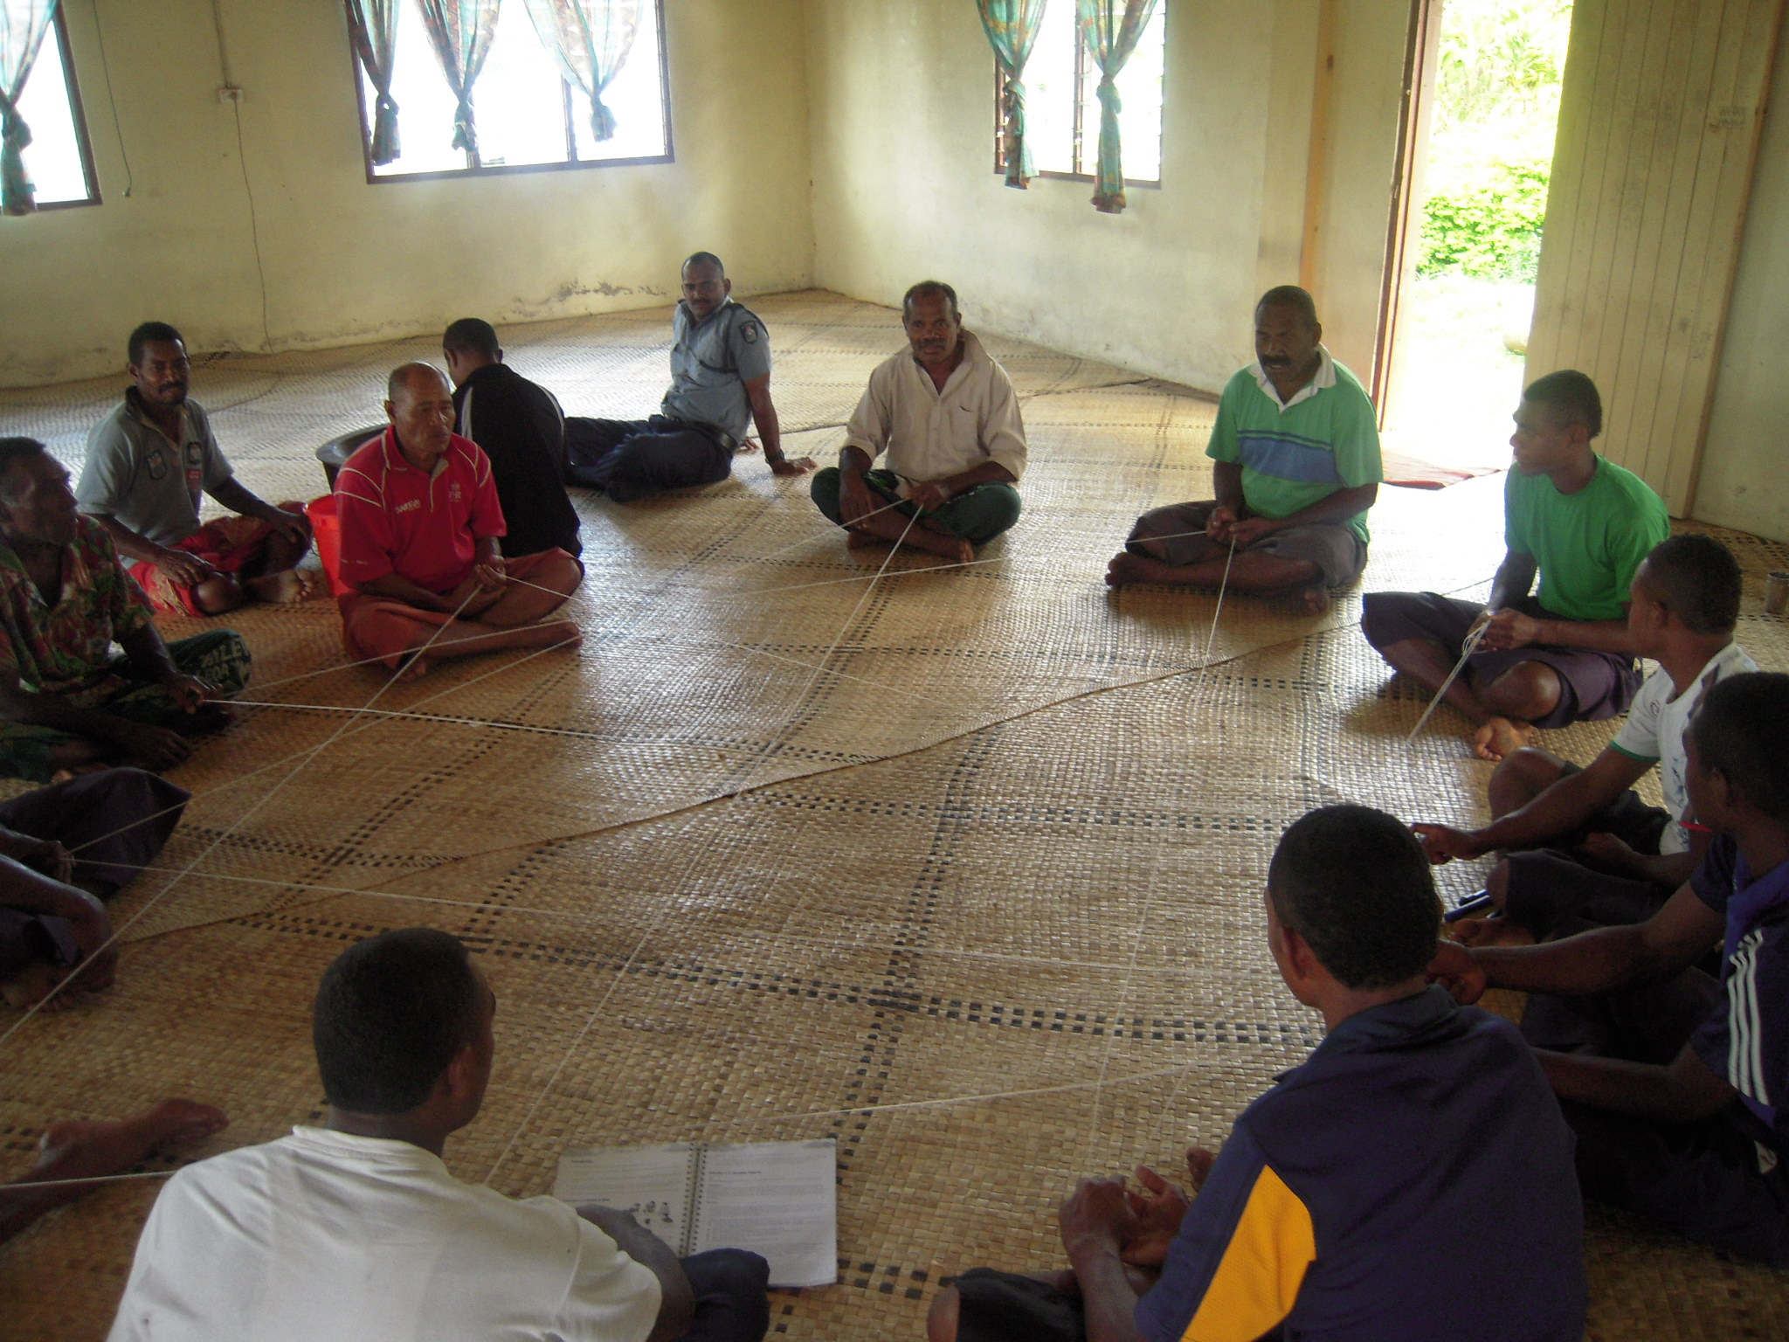
Cont.
Daria
Peace Corp
Mali Island
Matata Settlement - FJN+ Team

Slide 4
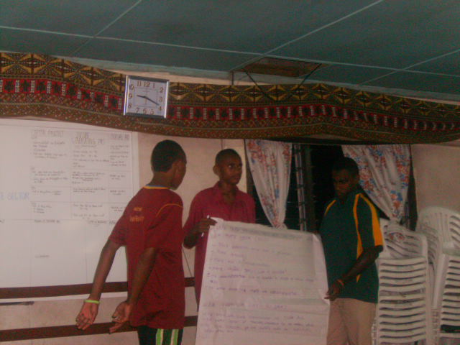
Community Name | Co-Facilitator | Progress
Naitutu | Sekove Delai | Completed
Waikato | Alesi | Completed
Kalabu | Iliesa. | Session 7
Nacula | Asivorosi | Session 2
Namoli | Kelera | ________
Daria | Todd | Session 5
Mali | Christian | Session 8
Matata | FJN+ Team | Completed

Slide 5
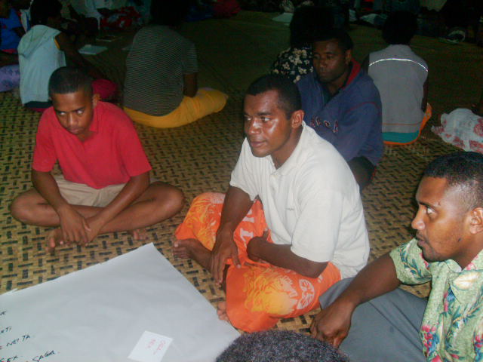
Challengers
Delay- starting
Community commitments/attitudes
Location
Community facilitator availabilities/dependent on co-facilitators to run the sessions.
Organizing the four groups
Understanding of the M&E component bu communities.

Slide 6
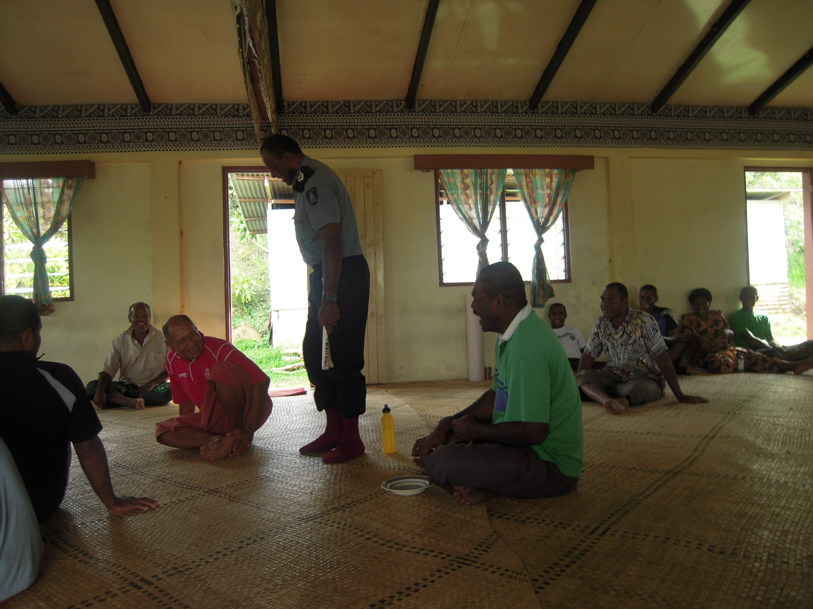
Successful Stories
Communities are able to unite due to the nature of stepping stone.
Villages are taking ownership of the program
Other villages are showing their interest in the program.
Facilitators are being invited to conduct sessions in other villages or religious program

Slide 7
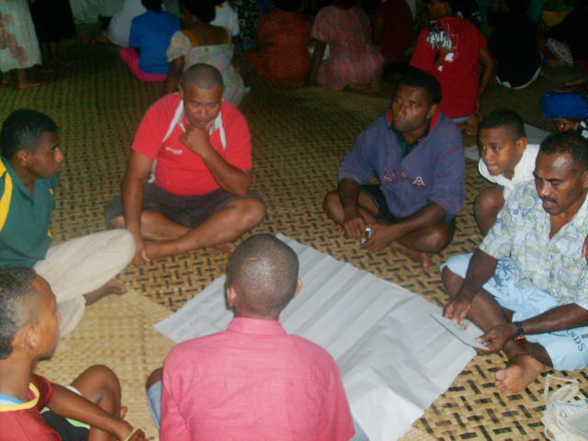
Cont..
Change is evident as stepping stone progresses.

Slide 8
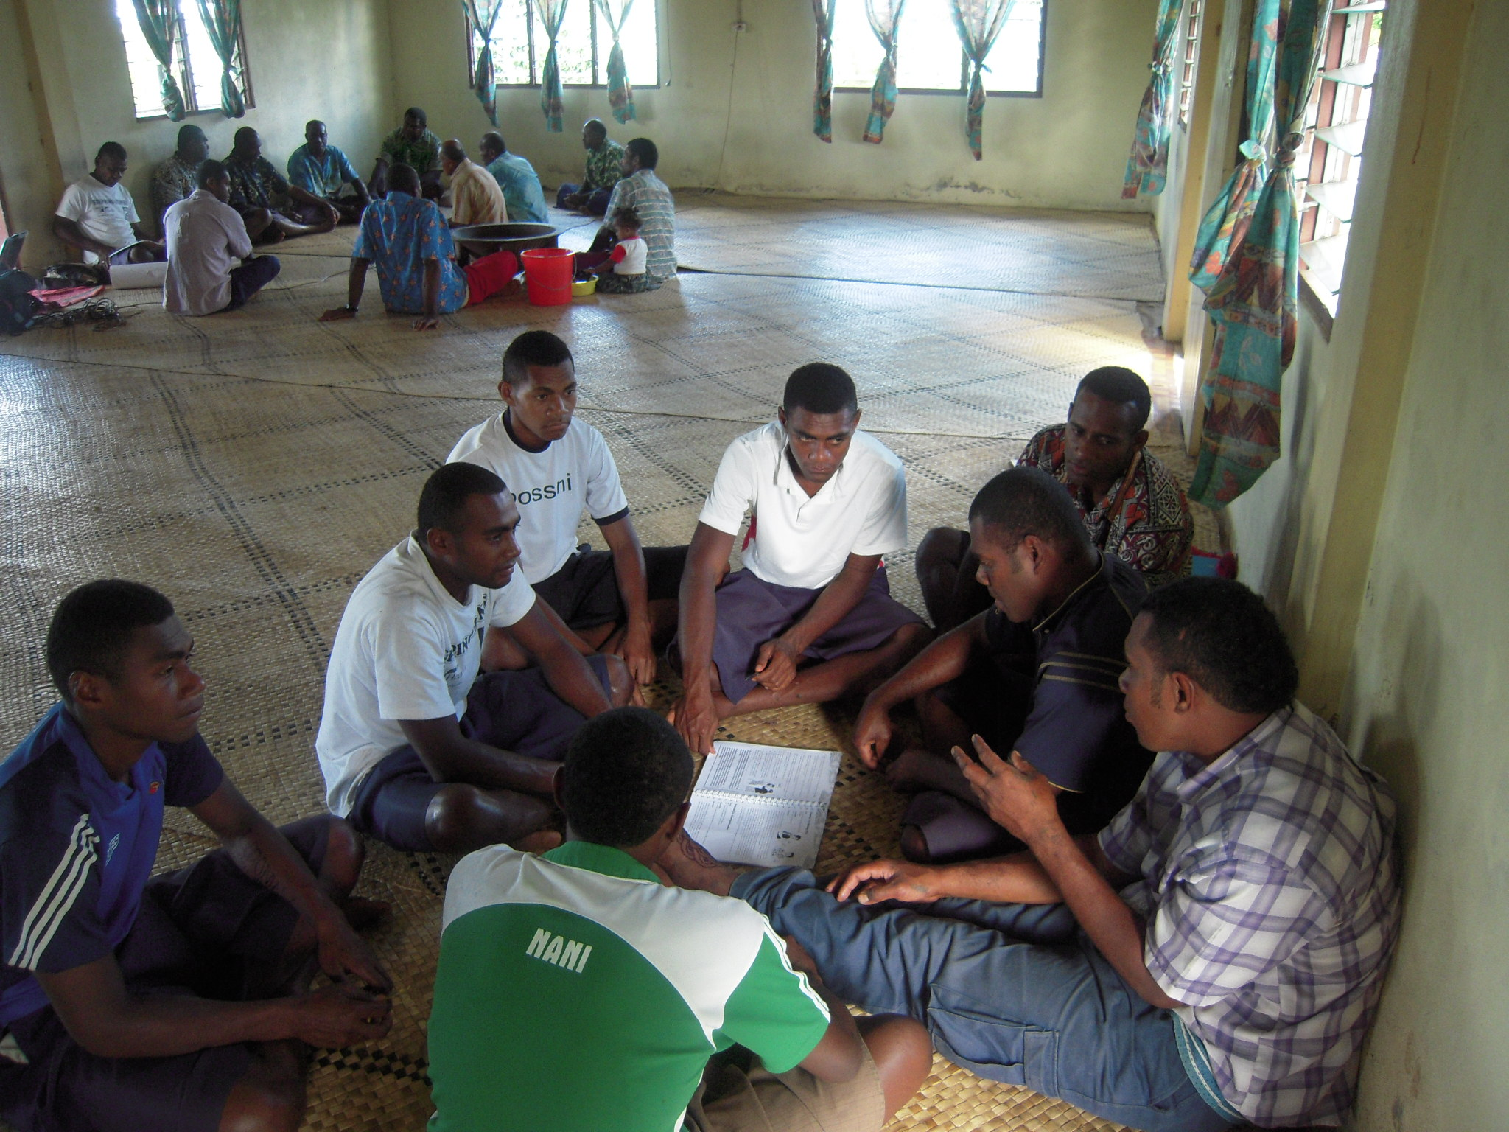
Recommendations
More visit from the coordinating team
Selection of community facilitator
If some incentives could be organize for the community as a whole.
Need to have a local Version/Translation of the M&E Tool.

