Slide 1
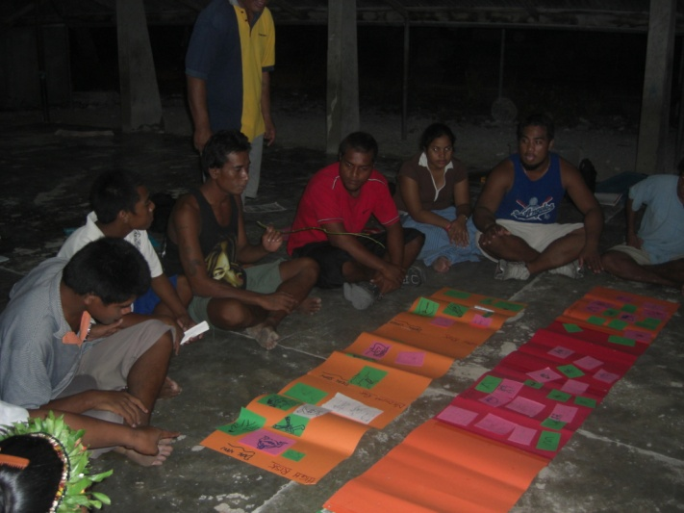
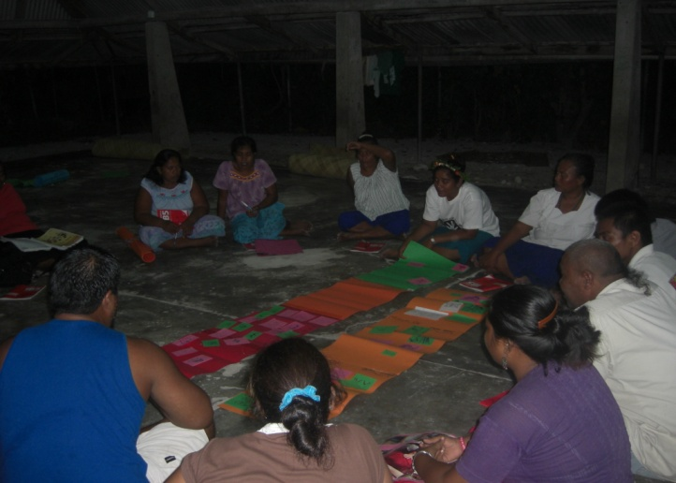
Stepping Stones Presentation
Kiribati

Slide 2
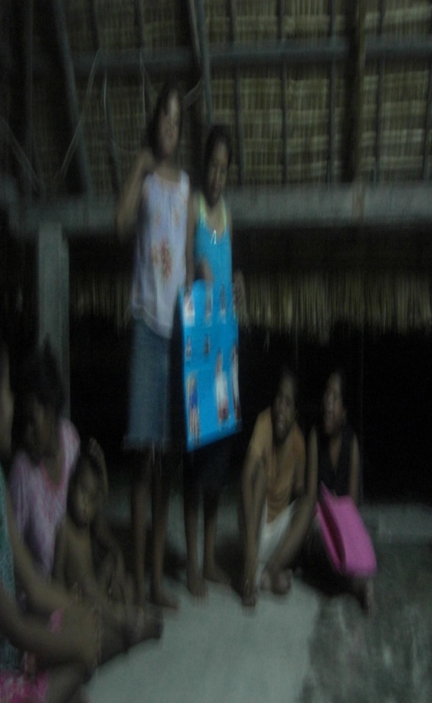
Implementation
2007 –2008
2 Pilot SS Training
2009 – National Training
2010 – Rolling Out of SS (Bikenkua Community)

Slide 3
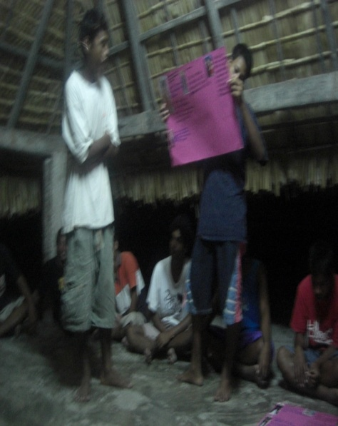
SS Communities
Active Communities
Takoronga Community
-1 Older Men
-8 Y/M
6 O/W
24 Y/W
Bikenikua Community
8 O/M
12 Y/M
10 O/W
16 Y/W

Slide 4
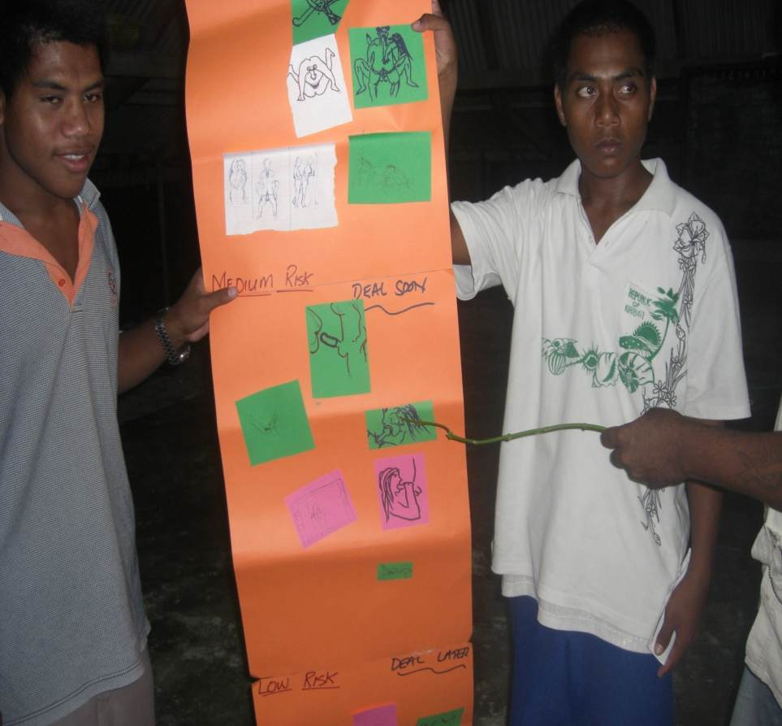
Partner Organisations
Kiribati Family Health Organization
Adolescent Health & Development
Kiribati Red Cross Society
Kiribati Christian Living
Kiribati Seafarers Union

Slide 5
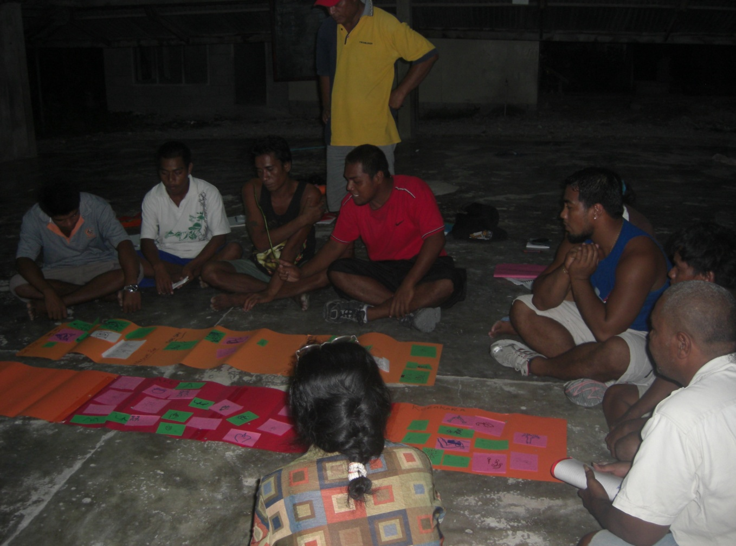
Resources Developed
Posters
Banners
Leaflets

Slide 6
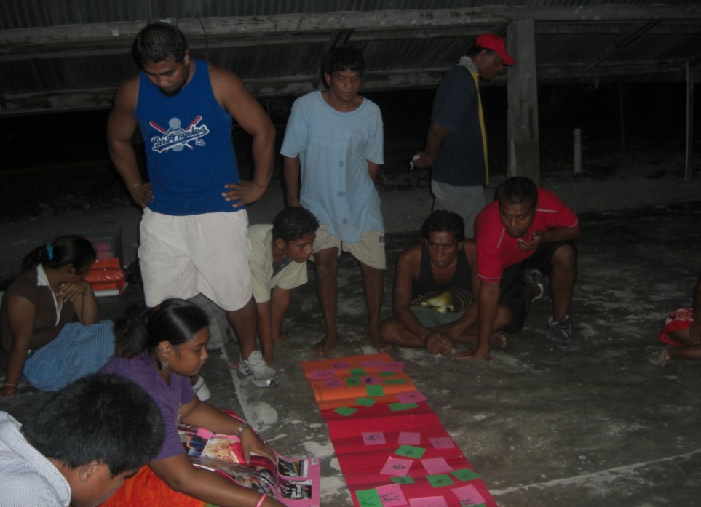
Issues & Challenges
Incentives
Incomplete Training
Community commitment
Loosing out Community SS facilitators

Slide 7
Lesson Learned/Action Taken
Training Ceased / Liaised with Community Leaders
Facilitators not committed/Signed agreement

Slide 8
Capacity Needs
Gender Equality
Domestic Violence
Family Planning
M& E

