Slide 1

COMMUNITY BASED CONDOM DISTRIBUTION
IDENTIFYING TARGET GROUPS & STRATEGIES TO REACH THEM
Isikeli Vulavou
Programme Associate
Notes:
During my presentation we will be covering:
What is results based management?
Why do we adopt Results Based Management or why use RMB?
We look at a definition of Result and the Results Chain through the various levels and hierarchy;
How do we measure results?
RBM as a tool for planning and then we will look at RBM as a tool for M&E
RBM as a tool for reporting and finally draw some concluding remarks.
I know that many of you have been to many past annual review and planning workshops and most of these concepts have been presented to you and you are familiar with, however for the benefit of the new country participants and for the benefit of refreshing our minds and knowledge on concepts of RBM, I will be covering most of these issues again in my presentation.

Slide 2

Step 1: Understanding vulnerability and risk in your community
Effective projects [particularly communication including condom distribution] focus on researched community at risk
How do you collect information about the community at risk?
Where can you go to collect more information on risks?

Slide 3
Risk and Vulnerability
Risk refers to an individual person’s attitudes or behaviours, such as; not washing one hands before a meal, having more than one sexual partner or practicing unsafe sex or not using clean needles when tattooing.
Vulnerability is about a person not having the power or ability to make choices or to act on them. For example, a young person may not be able to get information about STIs or access condoms, not having access to medication

Slide 4


Why Consider Risk Factors?
A clear understanding of the risks that expose individuals to a health issue is essential for planning communication activities and strategies.
One reason for developing a campaign is to make individuals aware that certain attitudes and behaviours can place them at risk of getting sick.
These attitudes and behaviours are called risk factors.

Slide 5
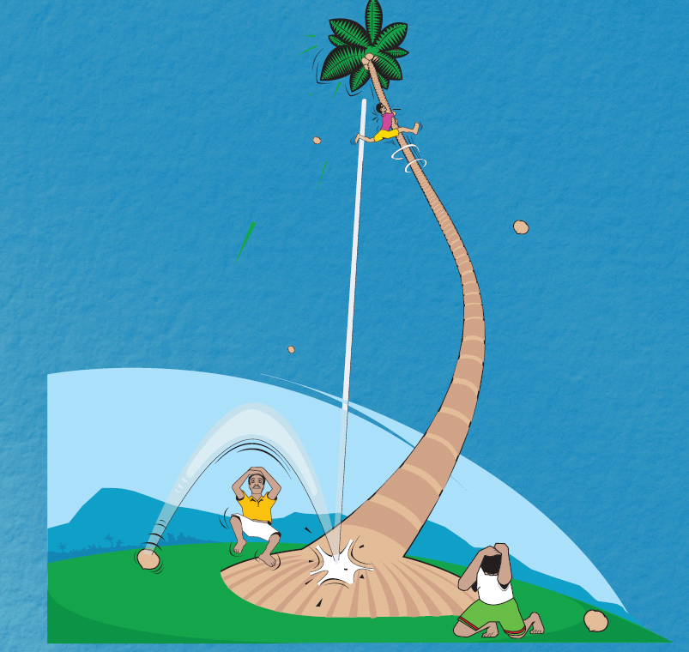
Activity: What are the risk factors in your community?
What attitudes and behaviors are putting people at risk?
What are some places that may have useful information on risks and vulnerability?

Slide 6
Risk Mapping Exercise
Draw map of your community
Mark places/events where certain groups become involved in risky activities
Use different colors and symbols to mark different places/types of activities
Which settings (locations) or events are the most risky?
Risk Mapping - Analysis of risk settings & events
  Where do people engage in risky behaviour?
  How many people and who go there?
  Any links between the places?

Slide 7

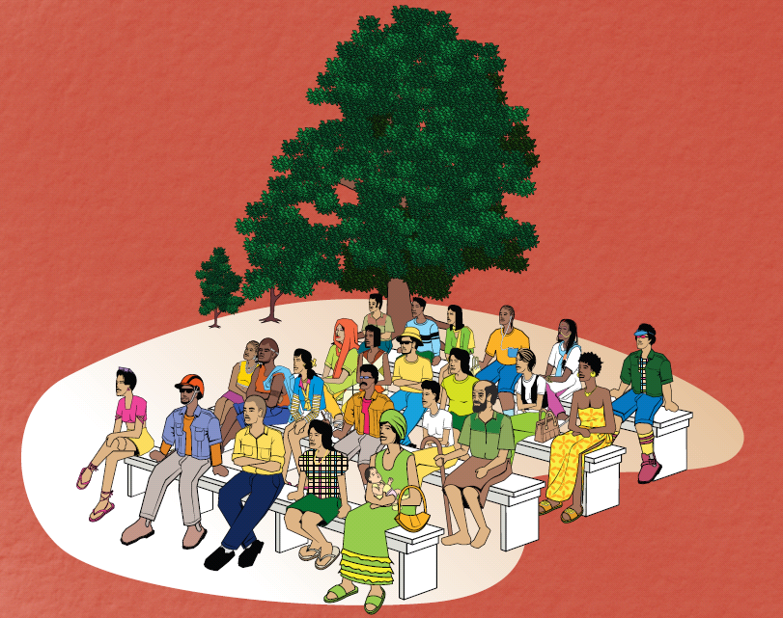
2. Identifying & assessing
audiences

Slide 8
Audience/Target Audience/Participant group/Key population
Group of people you are trying to reach with your communication project
It includes people with similar behaviours and attitudes that the communication project intends to change

Slide 9
Activity
Which group(s) of people is at greatest risk in your community?
Which group(s) needs the health information or services and products like condoms the most?
Which group(s) suits your organisation’s objectives?
Which group(s) do you have the experience and the resources to work with?

Slide 10
Primary & Secondary Audiences
To develop communication, it is important to identify the target audience as clearly as possible.
Primary audience - main groups whose related behaviour the program is intended to influence.
Secondary audience- groups that influence the ability of the primary audience to adopt or maintain appropriate behaviours
Notes:
Target populations are defined as primary or secondary.
Secondary populations - For example, an HIV program may seek to increase condom use among sex workers and clients (primary populations). But to achieve this objective, it may be necessary to change the behaviour or gain the support of brothel owners and police (secondary populations).

Slide 11
Target Populations Include:
 Individuals at high-risk or vulnerability farmers, parents, sex workers and their clients, out-of-school youth, police or seafarers (fisherman)
 People providing services health & community workers, educators, counsellors and social service workers
Policymakers (politicians)
Leaders and authorities, formal and informal local and national police, traditional, community and religious leaders
Local communities and families

Slide 12
Identifying Key Influences
To work out who influences the target audience’s
knowledge and attitudes about a particular
health issue, it is important to ask these types of questions:
Who suggests ways that they can prevent or treat the health problem?
Who influences their decision to seek assistance in preventing or treating?
Who influences their decision to try certain products or practice certain health behaviours?
Who influences their decision to continue or not to continue their new health behaviours?
Notes:
Some secondary target audiences are known as gatekeepers or key influencers.
Gatekeepers are usually influential leaders in a community.
Peer educators and outreach workers are another type of influential leaders. They are a special case since they are selected from the primary target audience.
After you have identified your potential audiences, find out who influences their health behaviors. The goal is to mobilize these groups to influence the primary audience in favour of the healthy behaviors.

Slide 13

Planning using five integrated actions/strategies
1. Administrative Mobilization/
Public Relations/Advocacy
2. Community Mobilization
5. Point-of-service-promotion
4. Interpersonal communication
3. Advertising

Slide 14
Communication Actions
1. Administrative Mobilization/ Public Relations/ Advocacy
Putting the recommended healthy behaviour on the public and administrative management agenda via the mass media:
  news coverage, talk shows, soap operas, celebrity spokespersons, discussion programmes; meetings/discussions with various categories of government and community leadership, service providers, administrators; official memoranda; partnership meetings; press conferences and press briefings.
Public needs to have a sense of the urgency of a health issue and a sense of being at risk in order for a recommended healthy behaviour to be fully considered.
If we do not have the full and enthusiastic support of health management and administrative staff for a particular health campaign - unlikely to have health staff respond appropriately to those seeking the means to carry out a particular healthy behaviour.

Slide 15
Communication Actions
2. Community Mobilisation
Engaging community institutions, community governance structures, and community leadership in examining the recommended behaviour and in arousing community involvement with families and individuals.
The communication actions include participatory research, community group meetings, partnership meetings, traditional media, music, song and dance, road shows, community drama, supportive environment: community sound trucks or other mobile sound systems, leaflets, posters, promotional bicycle riders visiting villages, etc.
Keen community involvement advances the adoption of healthy behaviours.

Slide 16
Communication Actions
3. Advertising, (Promotion and Incentives):
Using the techniques of advertising via radio, television, newspapers and other available media (such as posters, banners, billboards), engaging people in reviewing the merits of the recommended behaviour vis-à-vis “cost” of carrying it out.
The private sector has shown us the special and powerful contribution of advertising (done in M-RIP fashion) in prompting behavioural responses.
In addition, one may suggest various modest incentives and ways in which to brand the behaviour and promote it for behavioural consideration.

Slide 17
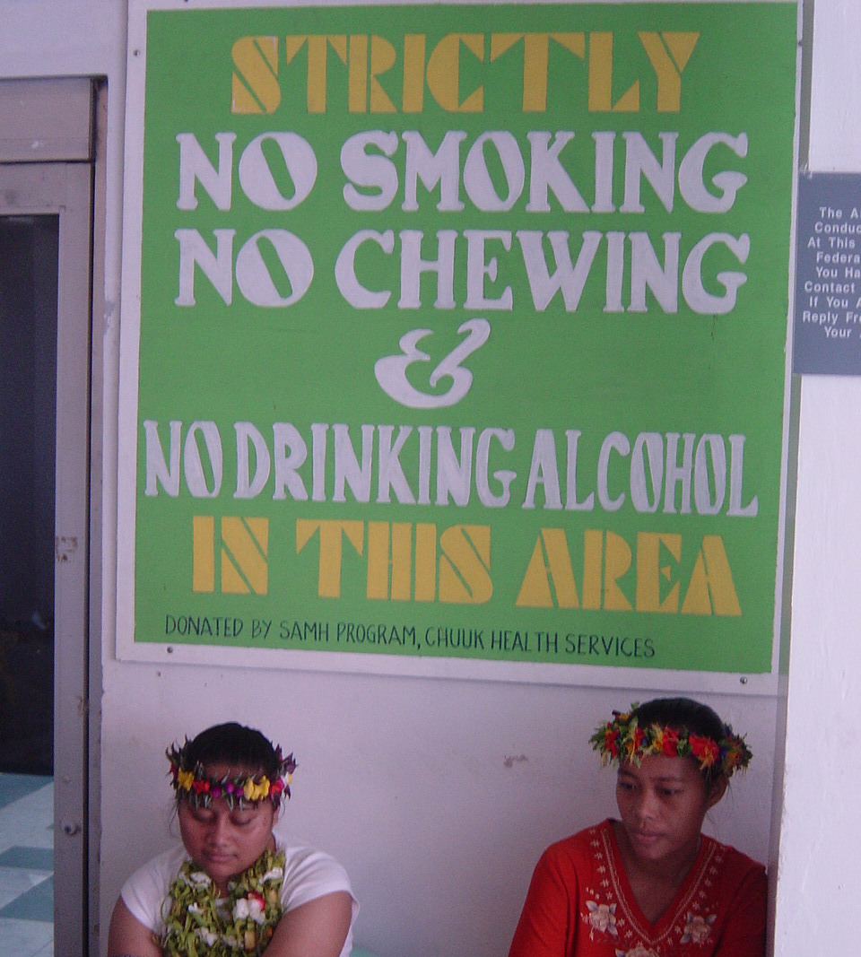
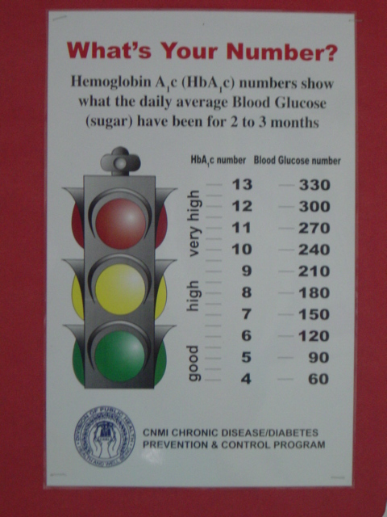

Slide 18
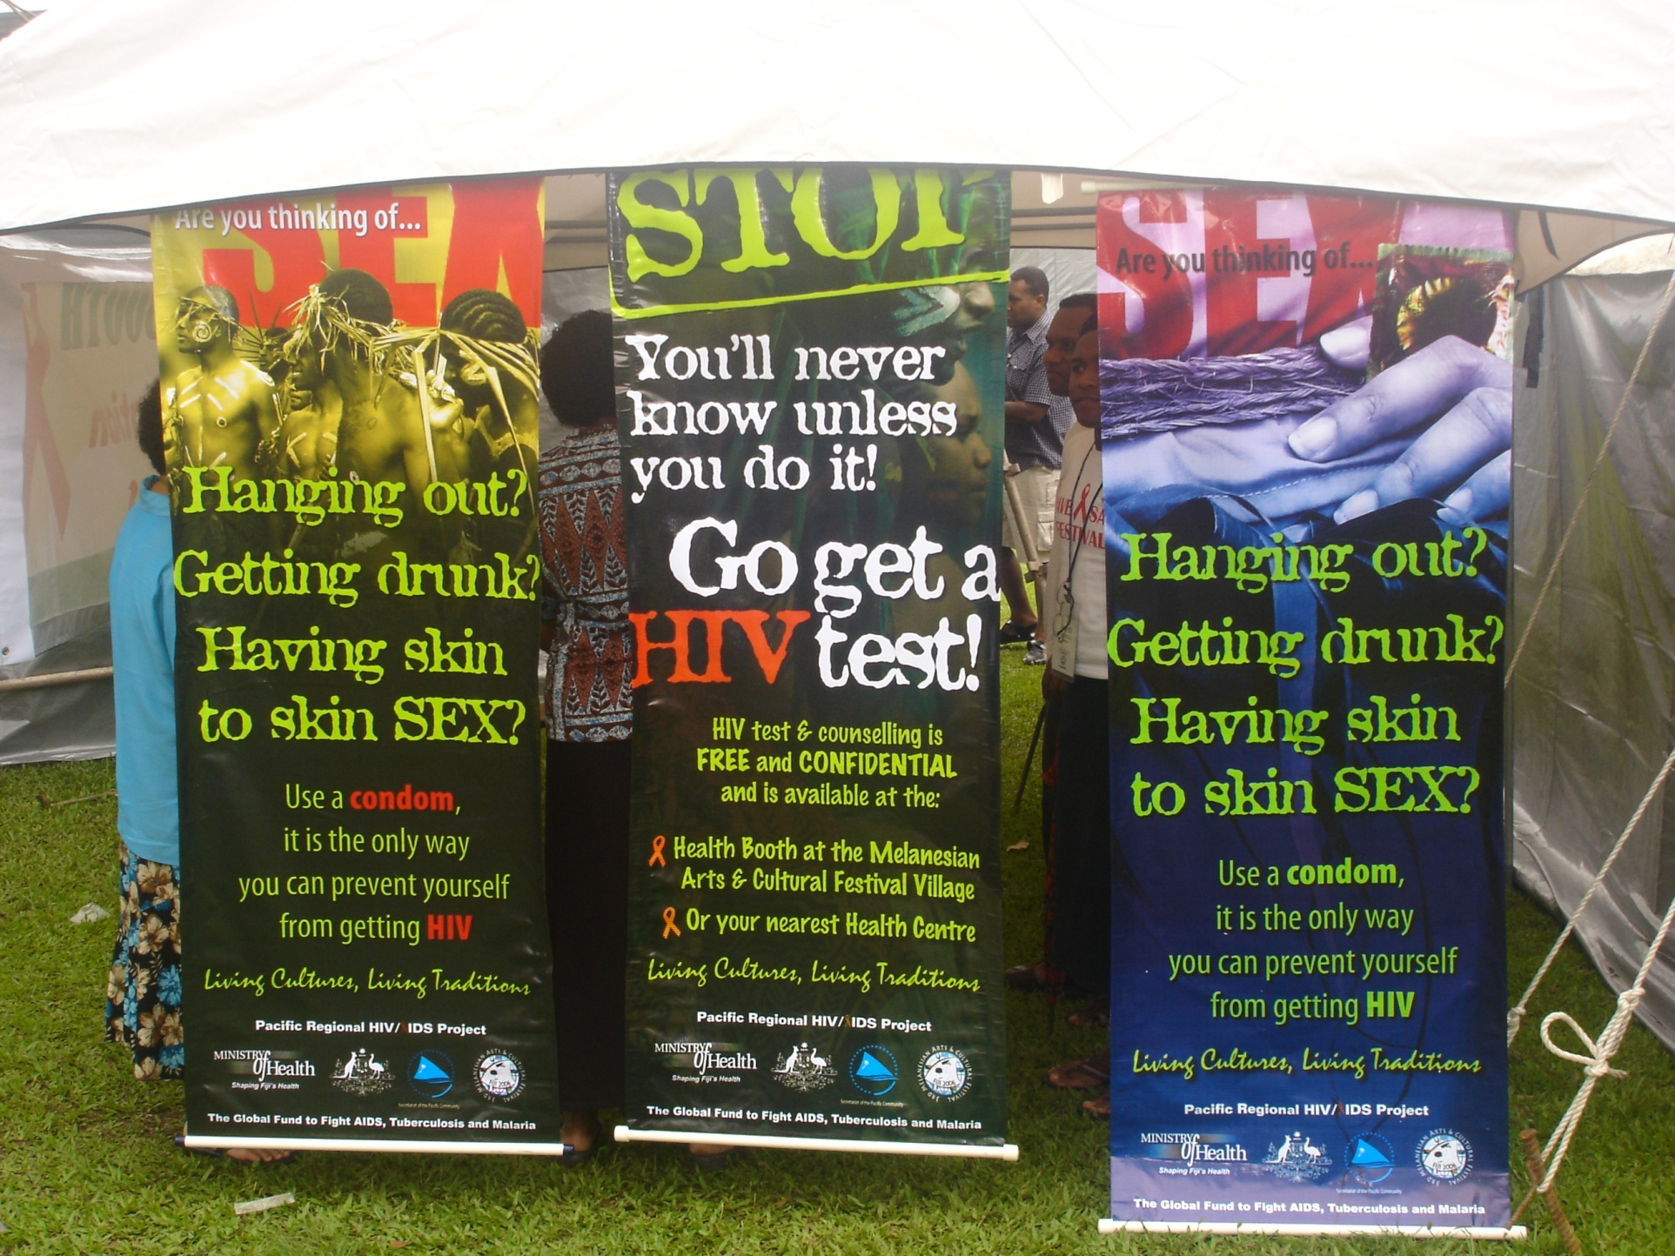

Slide 19

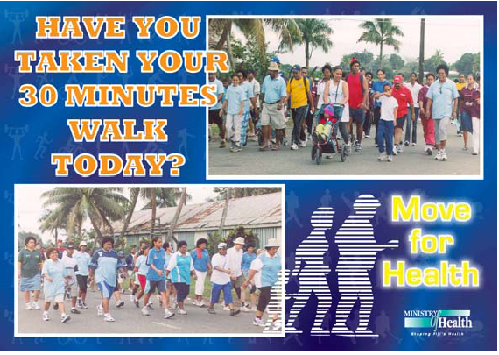

Slide 20
Integrated Communication Actions
4.Personal Selling/Interpersonal Communication
Involving community volunteers, community health workers, school children, social development field staff, at the community level, in homes and particularly at health care service points, in engaging others with appropriate informational literature and additional incentives
“Personal selling” has been the most powerful consumer communication approach for some of the most successful consumer companies in the world: e.g. Coca Cola, Fuller Brush, Avon, and HerbaLife.
Interpersonal communication holds a similar powerful role in engaging people in taking action on health issues.
  Instead of coming to a health booth or a health centre why not, when appropriate, the personal delivery of the “health behaviour” to one’s door
It is crucial that these door-to-door “personal sellers” be properly trained for their tasks (especially the communication dimension) and are appropriately dressed to enhance perceptions of credibility and expertise.

Slide 21
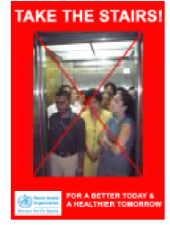
Communication Actions
5. Point-of- Service Promotion:
Promote via visible promotional signs and symbols at service point the easy availability and accessibility of the means for carrying out a recommended healthy behaviour.
In many countries, it is far easier to find signs promoting the availability of Coca Cola than it is to find a sign pointing to a health centre. In the same way that people need reminders for the fairly obvious (where to buy Coca Cola), people need reminders of where the health centres are and what services are provided.

Slide 22
Activity:
List activities under each action area you think appropriate to achieve your behavioural objective
Administrative Mobilization/ Public Relations/Advocacy
Community Mobilisation
Advertising, (Promotion and Incentives)
Personal Selling/Interpersonal Communication
Point-of- Service Promotion

Slide 23
Group Activity
In your groups, brainstorm and fill in the table on the next slide
First think about the actual situation in the communities you come from and then try and identify potential target groups in your communities. List them on the table. Try and recall those whom we have listed under “Who can use it?” slide in the Male Condom presentation and on the Female condom brochure
List the barriers that may need to be overcome in order to successfully promote condoms to the target groups on your list
Also brainstorm on the strategies that you will use to appeal to each target group
Notes:
Definitions:
Some definitions that we need to note at the threeresults levels:
If we implement an activity. It will lead to some results and outputs. The achievement of that output will lead to the achievement of an outcome and that outcome will contribute to an impact at the community and population at national level.
Outputs: product and services that results from the completion of an activity as a consequence of a development intervention;
Outcome: the likely or achieved short term and medium term effects of an interventions outputs;
Impact: the positive or negative, primary and secondary long term effects produced by a development intervention directly or indirectly, intended or unintended.
Ok, let us look at some examples: Outputs: 40 Peer Educators recruited and trained in selected areas and have improved advocacy & teaching skills and methods:
Outcome level: the achievement of that output will result in the Quality of peer advocacy increased in selected districts; and at
Impact level: the impact of that outcome at the community level could be or would be: unplanned and teen age pregnancies decreased or declined and increased youth and male involvement in reproductive health.
What are some of the changes that can be observed at the various results levels:
Outputs: products & services, skills and abilities (or operational change for that matter)
Outcome: Institutional & behavioral change
Impact level: change is visible on the young population through a reduction in unplanned and teen age pregnancies and increased youth and male involvement in Reproductive Health.

Slide 24
POSSIBLE TARGET AUDIENCES | POSSIBLE BARRIERS TO CONDOM USE | STRATEGIES & INFORMATION TO OVERCOME BARRIERS
Notes:
During my presentation we will be covering:
What is results based management?
Why do we adopt Results Based Management or why use RMB?
We look at a definition of Result and the Results Chain through the various levels and hierarchy;
How do we measure results?
RBM as a tool for planning and then we will look at RBM as a tool for M&E
RBM as a tool for reporting and finally draw some concluding remarks.
I know that many of you have been to many past annual review and planning workshops and most of these concepts have been presented to you and you are familiar with, however for the benefit of the new country participants and for the benefit of refreshing our minds and knowledge on concepts of RBM, I will be covering most of these issues again in my presentation.

Slide 25
Talking to the community
Gauging community attitudes to condoms
- is public discussion of safer sex and condoms socially acceptable in your community? If not, what does that mean for your work as a CD
- Have any public, community or religious leaders spoken out publicly about the need for HIV prevention? What does this mean for your work as CD?
- Have they spoken out against condoms? What does this mean for your work as CD?
- Do you need support of the community leadership to be a successful CD? If so what do you need to do to gain this support? How?
- If religious and community leaders express negative attitudes toward condom use, what is their reasoning? Can their attitude be influenced? How?
Notes:
Definitions:
Some definitions that we need to note at the threeresults levels:
If we implement an activity. It will lead to some results and outputs. The achievement of that output will lead to the achievement of an outcome and that outcome will contribute to an impact at the community and population at national level.
Outputs: product and services that results from the completion of an activity as a consequence of a development intervention;
Outcome: the likely or achieved short term and medium term effects of an interventions outputs;
Impact: the positive or negative, primary and secondary long term effects produced by a development intervention directly or indirectly, intended or unintended.
Ok, let us look at some examples: Outputs: 40 Peer Educators recruited and trained in selected areas and have improved advocacy & teaching skills and methods:
Outcome level: the achievement of that output will result in the Quality of peer advocacy increased in selected districts; and at
Impact level: the impact of that outcome at the community level could be or would be: unplanned and teen age pregnancies decreased or declined and increased youth and male involvement in reproductive health.
What are some of the changes that can be observed at the various results levels:
Outputs: products & services, skills and abilities (or operational change for that matter)
Outcome: Institutional & behavioral change
Impact level: change is visible on the young population through a reduction in unplanned and teen age pregnancies and increased youth and male involvement in Reproductive Health.

Slide 26
Talking to the community
Responding to barriers to condom use
- what do you think your peers will say about the fact that you are distributing condoms? What will you say?
What do you think your family will say about the fact that you are distributing condoms? How will you respond? What will you say?
What do you think religious leaders will say? Will different religious leaders have different reactions and opinions? How will you respond? What will you say?
Who are the gatekeepers in your community? List. Will you need to talk to them about distribution of condoms? What do you think their reactions and opinions will be? How will you respond? What will you say?
Notes:
Definitions:
Some definitions that we need to note at the threeresults levels:
If we implement an activity. It will lead to some results and outputs. The achievement of that output will lead to the achievement of an outcome and that outcome will contribute to an impact at the community and population at national level.
Outputs: product and services that results from the completion of an activity as a consequence of a development intervention;
Outcome: the likely or achieved short term and medium term effects of an interventions outputs;
Impact: the positive or negative, primary and secondary long term effects produced by a development intervention directly or indirectly, intended or unintended.
Ok, let us look at some examples: Outputs: 40 Peer Educators recruited and trained in selected areas and have improved advocacy & teaching skills and methods:
Outcome level: the achievement of that output will result in the Quality of peer advocacy increased in selected districts; and at
Impact level: the impact of that outcome at the community level could be or would be: unplanned and teen age pregnancies decreased or declined and increased youth and male involvement in reproductive health.
What are some of the changes that can be observed at the various results levels:
Outputs: products & services, skills and abilities (or operational change for that matter)
Outcome: Institutional & behavioral change
Impact level: change is visible on the young population through a reduction in unplanned and teen age pregnancies and increased youth and male involvement in Reproductive Health.

Slide 27
Roles and responsibilities of a Condom Distributor
Brainstorm
- What do you think are the roles and responsibilities of a CD?
Notes:
Why Monitor & Evaluate Performance?
Provide accurate and up to date information on progress
Provide regular feedback and early indications of progress or lack thereof;
To track actual performance/situation problems and success areas
Learning and decision making
To detect early signs of potential problems and success areas;
To take corrective actions;
To improve the design and performance of ongoing programmes
To generate knowledge about what works and what does not work
Improve accountability
To ensure that a programme/process continues to be relevant, and achieving results as intended
To make an overall judgment about the effectiveness of the interventions

Slide 28
Monitoring Condom Distribution work
Two kinds of information that participants may need to record
Where they have distributed condoms?
What difficulties or questions or negative attitudes have come up?
Which clients will want more condom each week?
Which clients need more print information?
Notes:
How do we monitor performance? Some key tools for Performance monitoring. Performance monitoring focuses on measuring progress towards achievement of results, rather than documenting how activities were implemented. A key tool for performance monitoring for programmes is the “Logical Framework” or LOGFRAME.
Logical framework – provides the basis for monitoring results through the following:
A concise summary of the project
A tool for appraising a project
A tool for monitoring progress made with regard to delivery of outputs and activities
A tool for evaluating delivery of outputs at the end of the project and progress towards achieving Outcomes and Goals

Slide 29
Monitoring Condom Distribution work
2. The other type is an inventory of the number of condoms and education materials distributed and the number on hand. This record guides the reordering strategy and will be submitted to your condom suppliers on a regular basis
Refer to handout
Notes:
How do we monitor performance? Some key tools for Performance monitoring. Performance monitoring focuses on measuring progress towards achievement of results, rather than documenting how activities were implemented. A key tool for performance monitoring for programmes is the “Logical Framework” or LOGFRAME.
Logical framework – provides the basis for monitoring results through the following:
A concise summary of the project
A tool for appraising a project
A tool for monitoring progress made with regard to delivery of outputs and activities
A tool for evaluating delivery of outputs at the end of the project and progress towards achieving Outcomes and Goals

